Slide 1
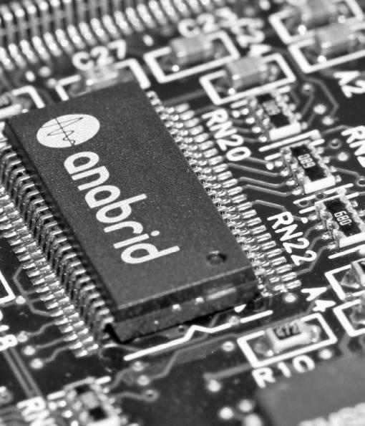
Anabrid: Analog Computing in the Post-AI Bubble Era
Dr. Sven Köppel
koeppel@anabrid.com
2026-05-19, 17:30 – 19:00, Series „Digital Pioneers“
Online Event
International Career Service Rhein-Main Carreer Services by
Frankfurt University of Applied Sciences,
Goethe University,
TU Darmstadt,
Hochschule Darmstadt,
Johann-Gutenberg-Universität Mainz,
Hochschule Rhein-Main

Slide 2
Agenda
1) Intro: From scientist to entrepreneur
2) „The Pitch Elevator“ on Anabrid
3) [optional] On the technology
4) How to Deep Tech in Germany
5) Double carreer & family time

Slide 3


Already bored?
Let’s make this interactive.

Slide 4
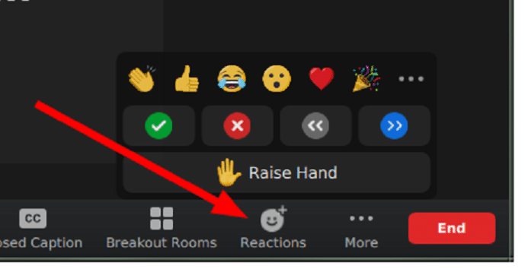
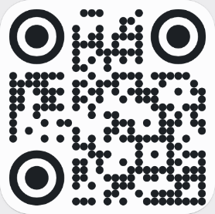
Already bored?
Let’s make this interactive.
1.
Please use the Zoom feature „raise hand“ or the chat function to ask questions!
2.
Let’s use a poll/survey feature to quickly collect input from participants.
<
Visit pe.app/svenk
Or scan QR code
with your phone:

Slide 5

Participant
survey

Slide 7


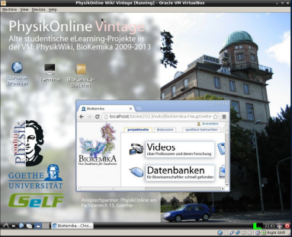







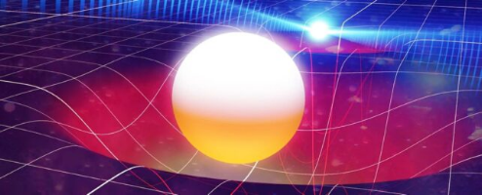

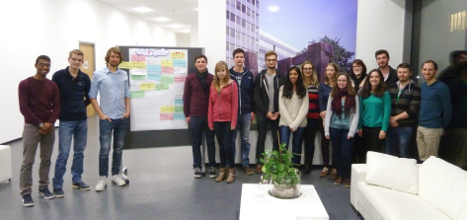
An illustrated CV
PhysikOnline @ GU, RiedbergTV
2011-2017
Quantum Physics & Applied Math
2014-2019
Interstellar [2014]
Nobel prize 2017 to LIGO

Slide 8
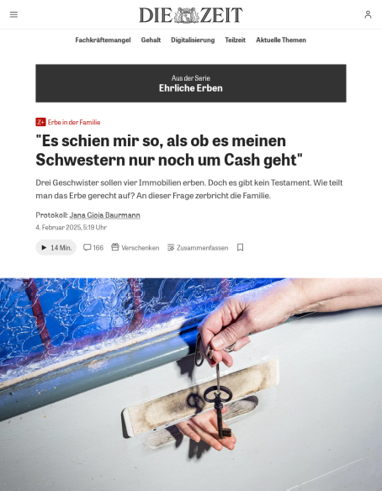
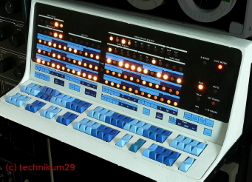

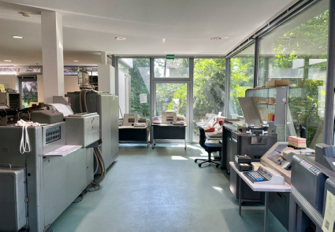
An illustrated CV
Technikum29 Computer Museum
near Frankfurt [2005-, 2018-]
PhD Baby
2017-
2018

Slide 9
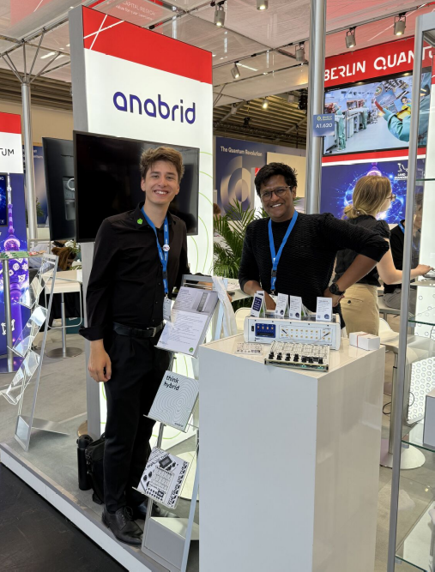
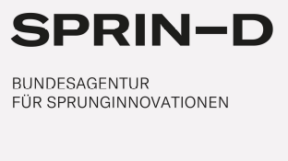
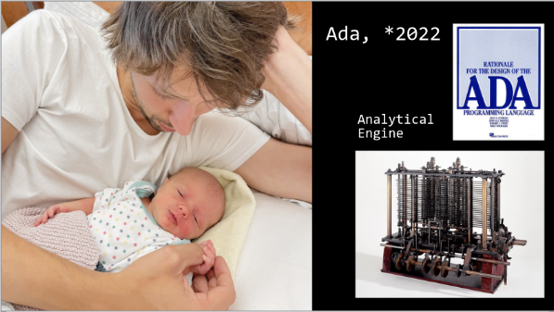




An illustrated CV
Anabrid Semiconductors
[2020-]
Startup Baby
[2022-]

Slide 10

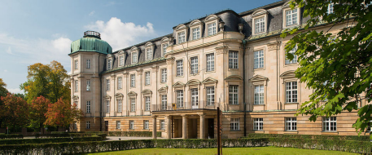
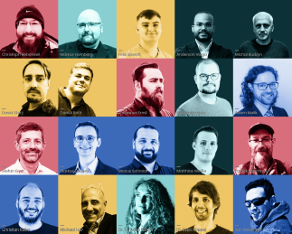



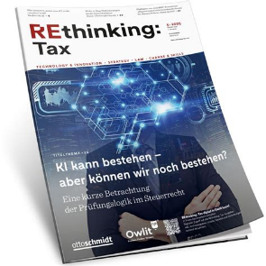
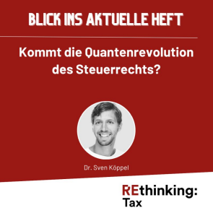
An illustrated CV
FG Münster
[2020-2025]
DenktMit eG
[2022-]

Slide 12
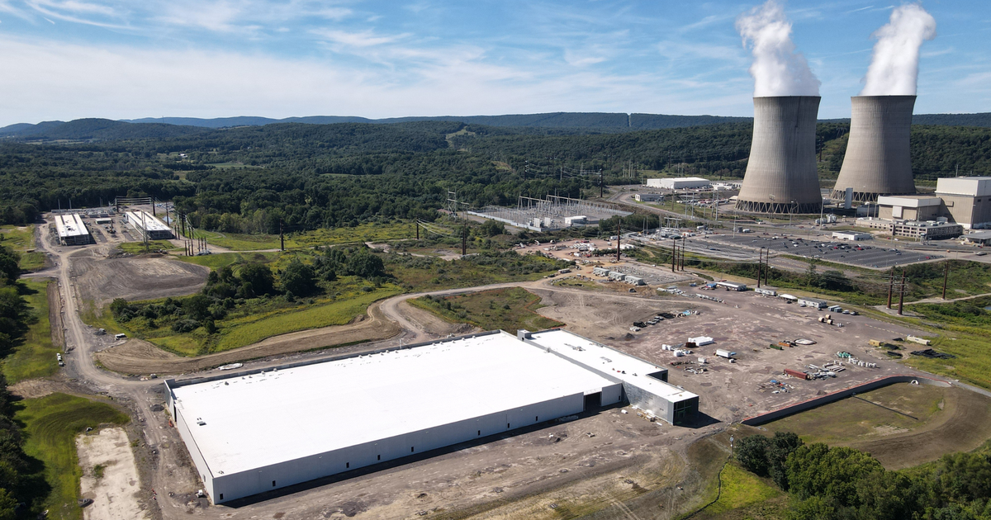
TECHNOLOGY

Slide 13
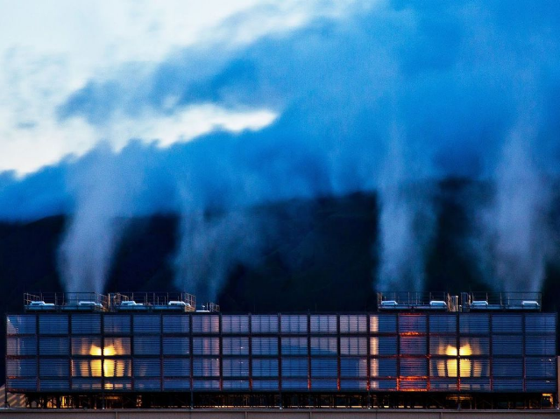
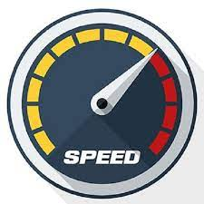
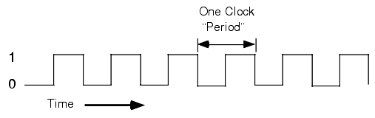
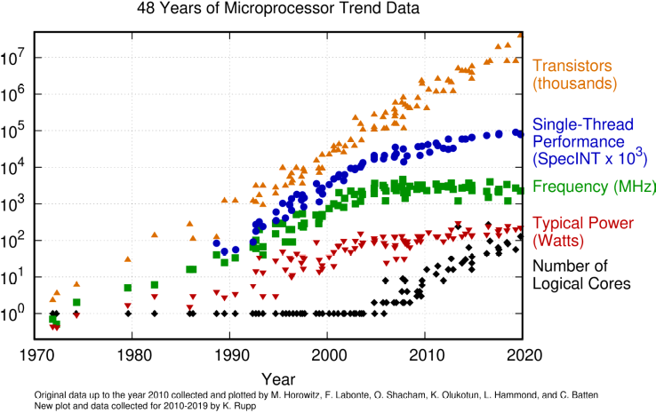
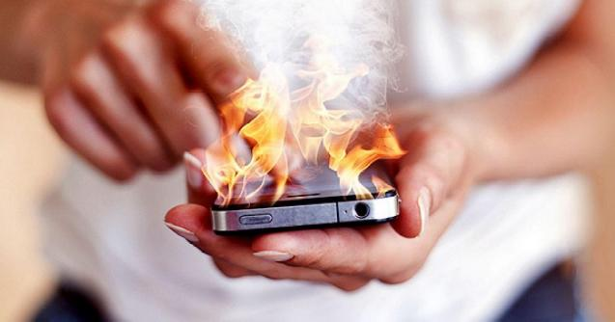
The Problem: Computing is inefficient and stagnating

Slide 14
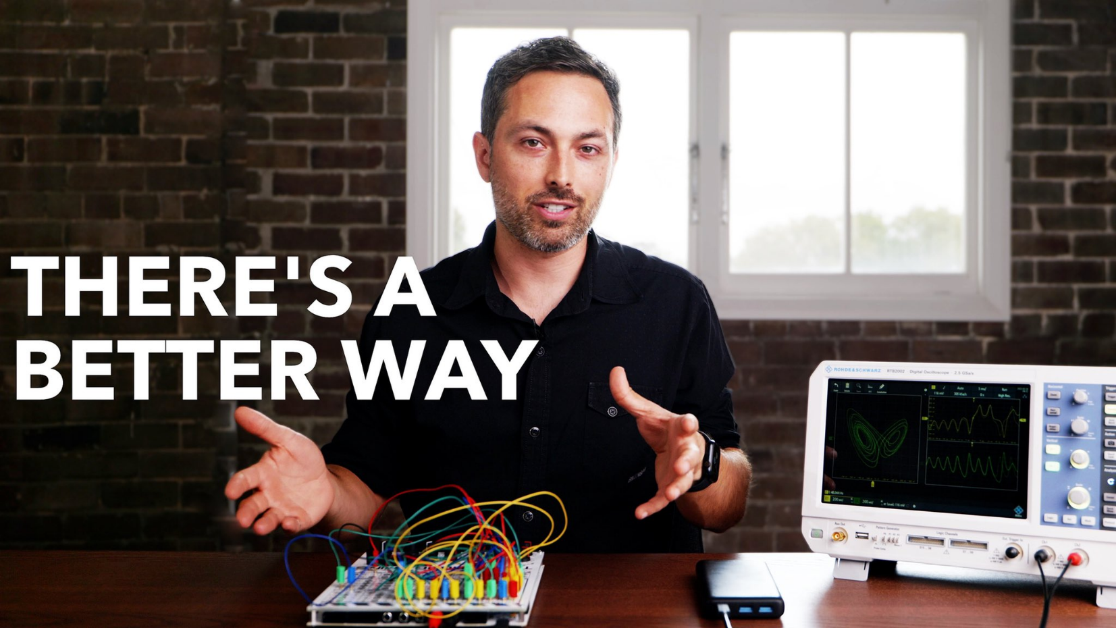
Veritasium @ Youtube: Future Computers will be radically different,
12 Million views

Slide 15
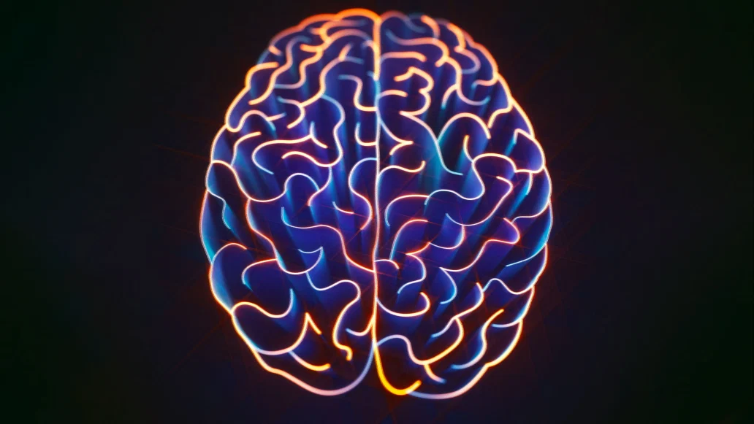
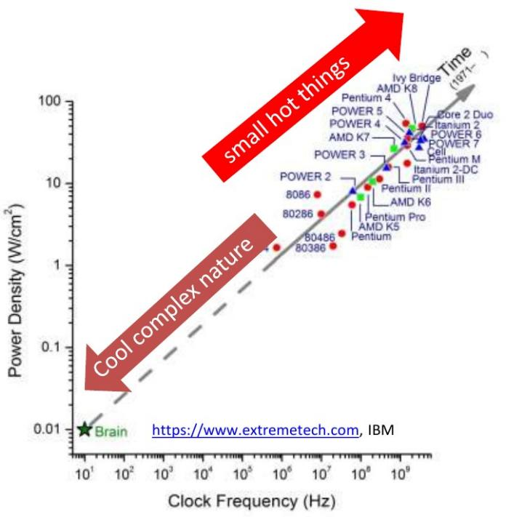
The Solution: Adopt natural computing like in the brain

Slide 16

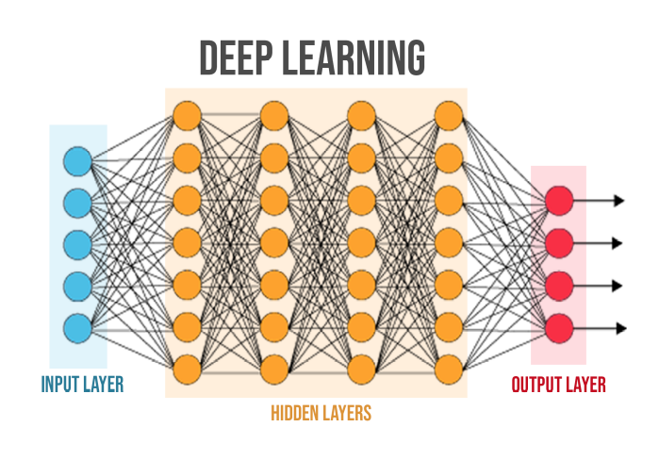
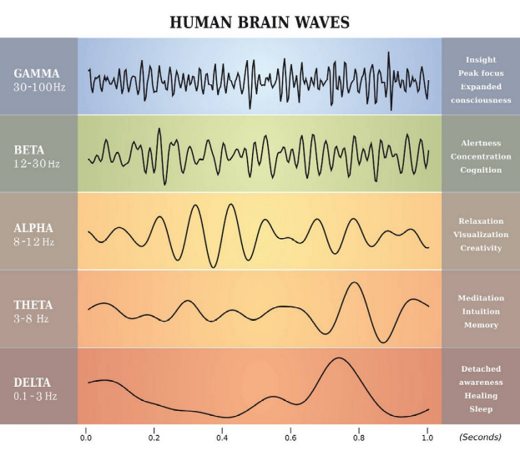
Compute as the Human Brain
Digital Arithmetics
Analog processes in nature
Symbolic computing & sparse linear algebra
Wave-based computing & dense interconnects

Slide 17

Confluence of past and future: Computing with Analogies
b
a
a+b=c

Slide 18
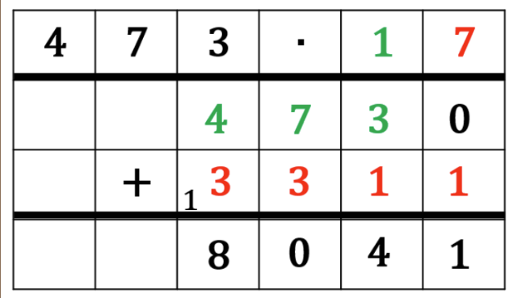
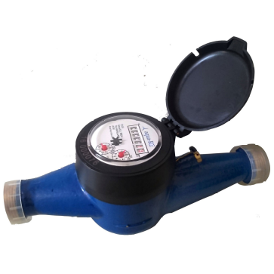
Analogues
Digital Arithmetics
Analog processes in nature
b
a
a+b=c
• Uses algorithms
• Inherently clocked and serial
• Based on memory
• Energy barrier, von-Neumann bottleneck
• Happens in real-time
• Continous and parallel
• Initial state preparation and
Measurement-based
• Resetting Moore’s law

Slide 19
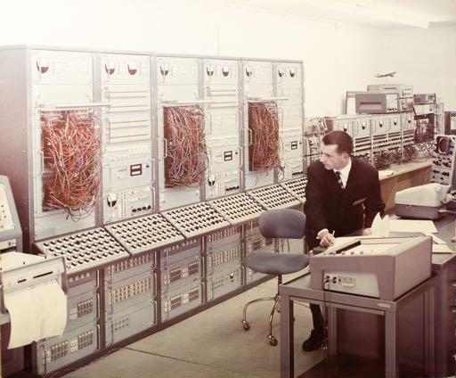
Confluence of past and future: Computing with Analogies

Slide 20
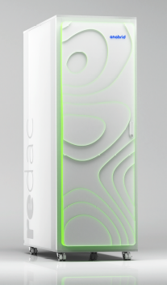
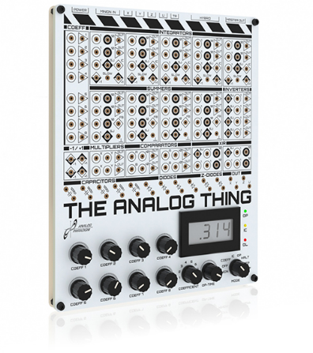
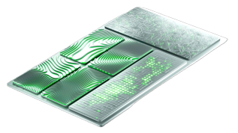

Rediscovering classical Analog Computing
Anabrid resets Moore’s law
The Analog Thing
»Hacker’s toolkit«
REDAC Analog Supercomputer
G-PAC: 65nm CMOS

Slide 21
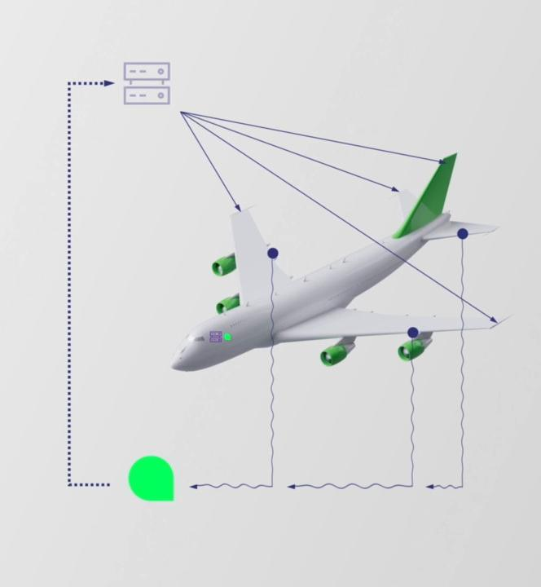

Reasons why to go analog
Talking to industry
Low
Latency
100%
Parallelism
Low
Power
Reduced
Complexity

Slide 23
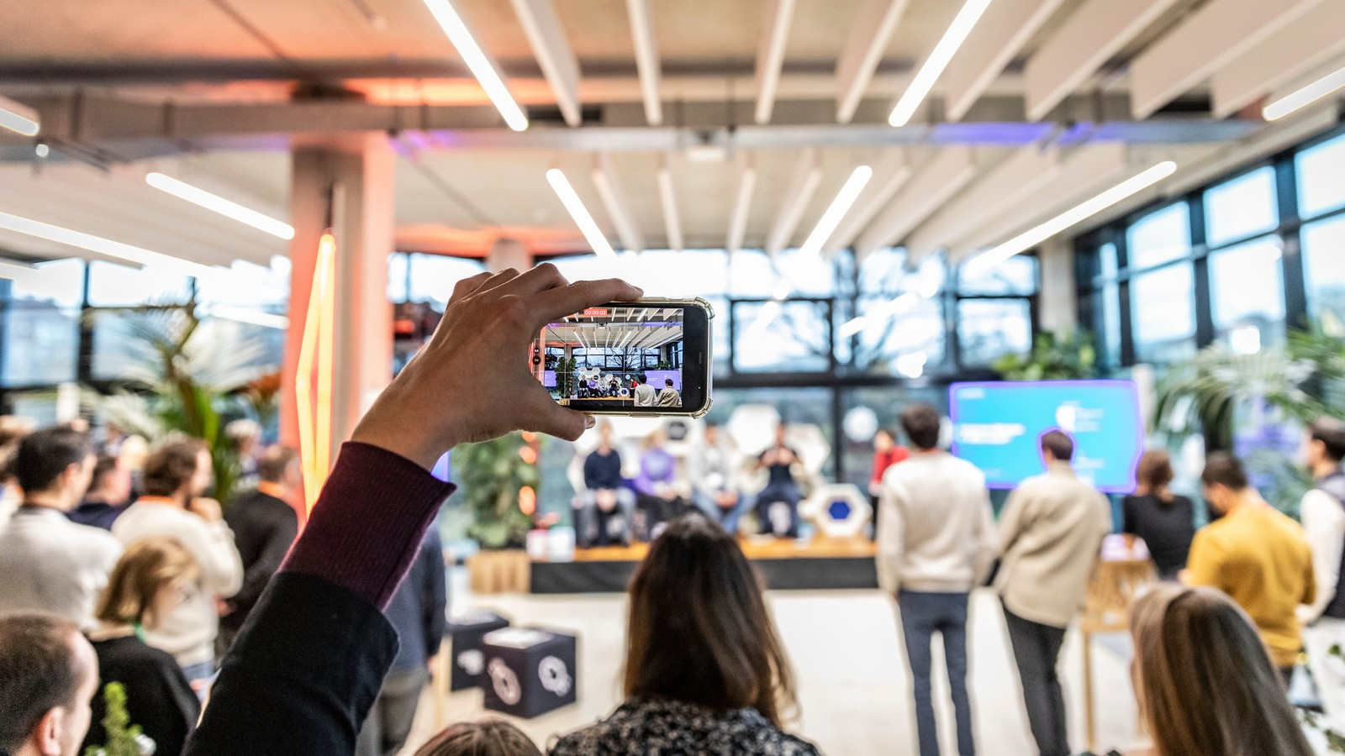
FOUNDING CULTURE

Slide 24
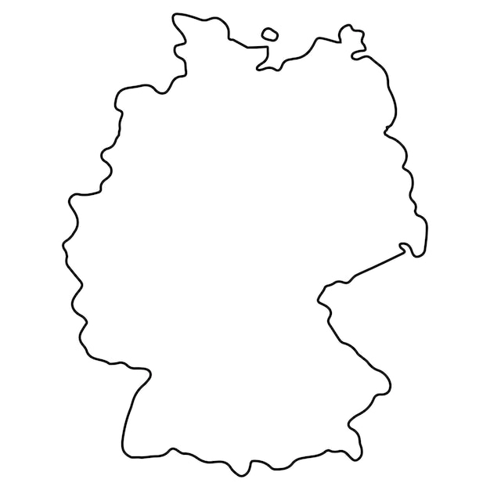

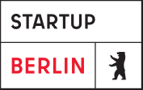











Opinionated
Landscape
Hamburg
Berlin
Dresden
Frankfurt
Rhein-Main
Heilbronn
München

Slide 25
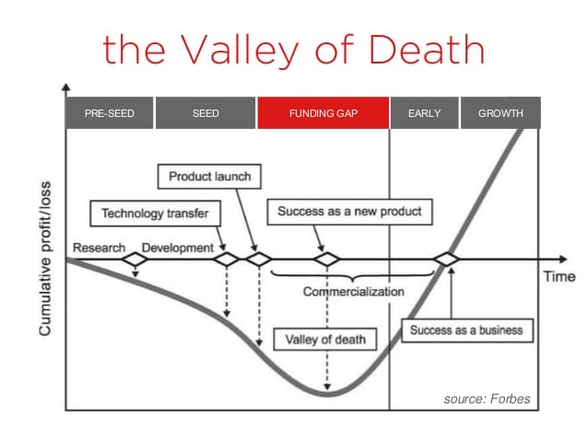
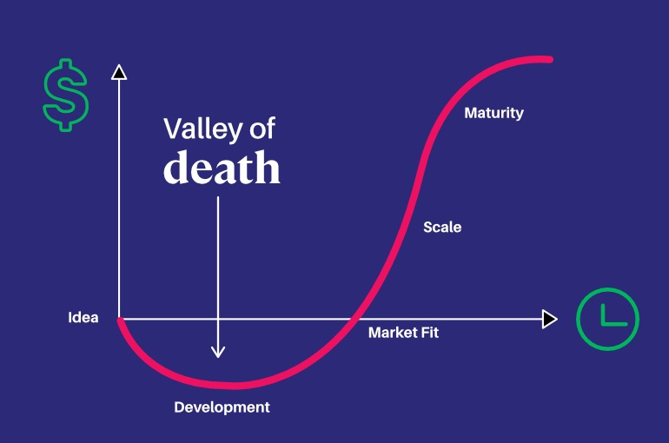
Funding situation in Germany

Slide 26
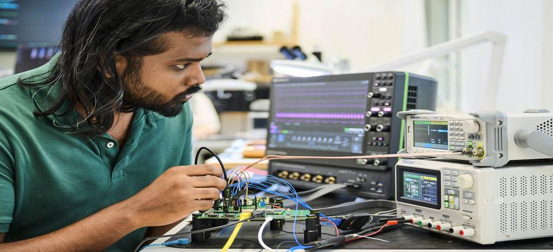
ANALOG
TECH

Slide 27
See
https://github.com/svenk/publications/blob/master/Talks/2025-07-14%20FPGA%20Paderborn/2025-07-14%20Analog%20FPGA%20Paderborn%20SK.pdf
for the shown slides shown with a deeper technical focus

Slide 28
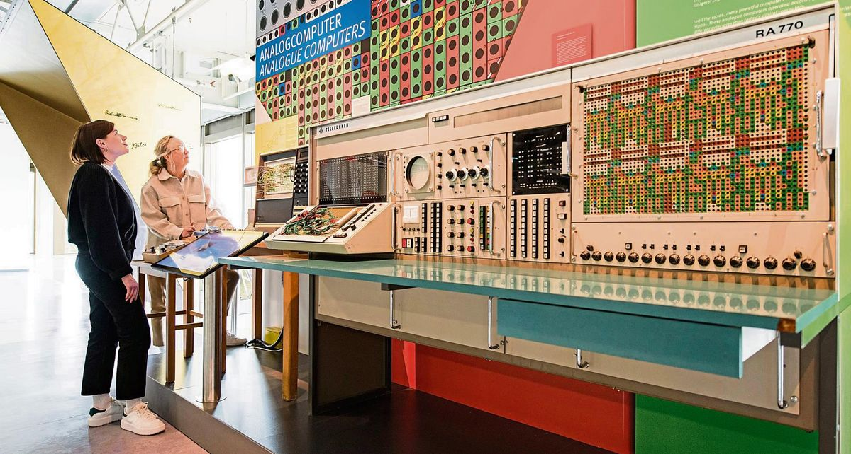
UPCOMING EVENTS

Slide 29
Upcoming events in Frankfurt
on Analog
Night Of Science @ Goethe University: June 12, 2026
Analog Computing Days @ Frankfurt School of Finance & Managament, June 11-12, 2026
https://analog-computing-days.org/
Upcoming cultural events in Frankfurt
on related topics
Thu May 28: Opening AI&QC center Bertramshof
technikum29: permanent exhibition
SCHIRN: „The World Throught AI“ special exhibition
Kreativwirtschaftstag May 05, Neue Kaiser, Frankfurt

Slide 30
Anabrid: Analog Computing in the Post-AI Bubble Era
Dr. Sven Köppel
koeppel@anabrid.com
Thank you for your attention!

